Slide 1
Unit 2 Colours
第1课时

Slide 2
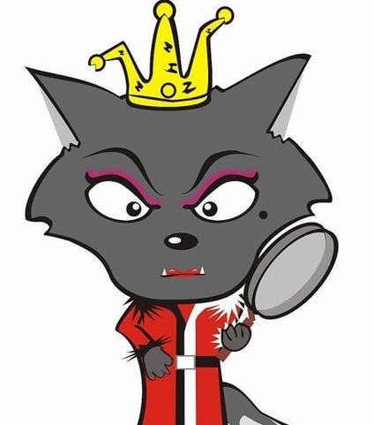
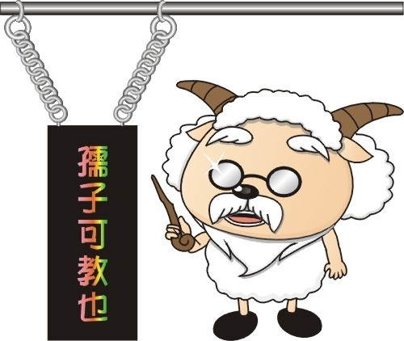
Who are they?
Mr Man
Miss Hong

Slide 3
This is ….
This is Mr Man .

Slide 4
This is ….
This is Miss Hong.

Slide 5
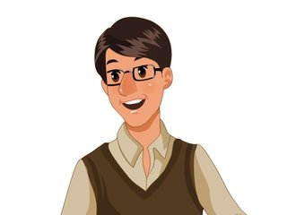
Guess!
This is ….
Mr Jones

Slide 6
Guess!
This is ….
Miss Green

Slide 7
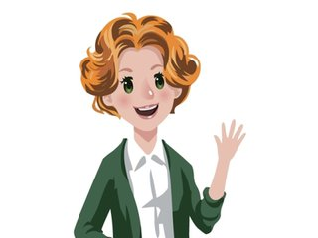
Let’s read
Mr Jones, this is Miss Green.
Good morning，Miss Green.
Good morning.

Slide 8
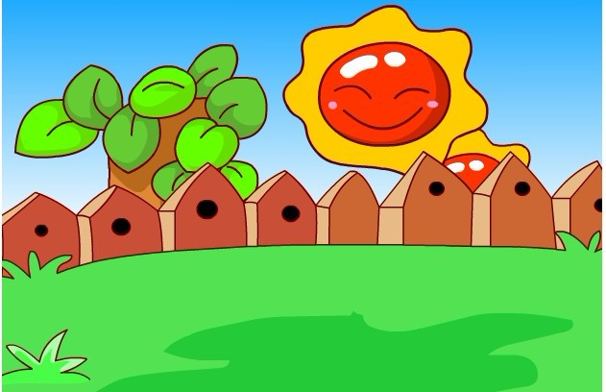
Sing a song

Slide 9
歌曲:
Good morning to you.Good morning to you.
Good morning，Mr Jones. This is Mr Jones.
Good morning to you.Good morning to you.
Good morning，Miss Green. This is Miss Green.

Slide 10
Let’s chant
This is Mr Jones.
This is Miss Green.
Good morning, Mr Jones.
Good morning, Miss Green.

Slide 11
Homework
Draw and say your classmates to your parents.

